Slide 1

DriverPass System Analysis
Brian Bentley – 12/6/2022
Notes:
Welcome to my DriverPass system! Introduce myself to the class.

Slide 2

System Requirements
User Registration - There will have to be a way to get students registered for classes from the school’s course catalog.
Content Management - There will need to be a way to manage the course content and allow users to download modules and other materials from many different operating platforms.
Security - The system will need a way to keep information secure. There will need to be a way to have SSO tokens and other 3rd party authentication applications integrated into the software
Availability - We will want the system up as much as possible but will have to research ways to plan maintenance of the system. There will have to be downtime and we will have to notify users.
Notes:
The two functional requirements that I chose were User Registration and Content Management. User registration is absolutely necessary for the users to be able to login to the system. Content management will be needed so that students can download the course content and study for their exams.
The two non functional requirements are Security, and Availability. Security, since the system will have to have login tokens and encrypt passwords and other sensitive information. Availability, since we will want our system up as much as possible and have to plan maintenance and upgrading only to short windows to keep the system alive.

Slide 3
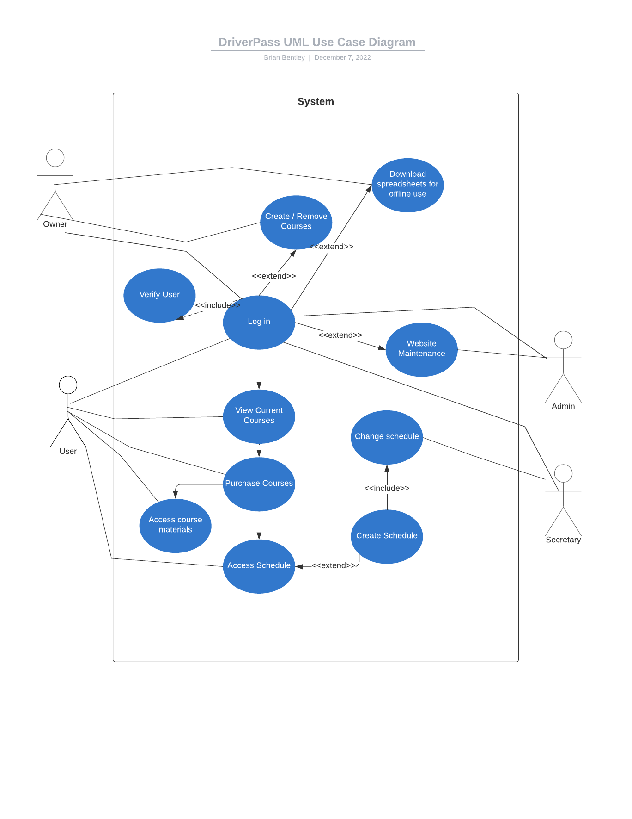
Use Case Diagram
Notes:
This use case diagram is of the overall DriverPass system. The actors here are the User, Owner, Admin, and Secretary. The use case are logging in, creating courses, creating schedules, creating accessible download materials for the students as well as purchasing courses.

Slide 4
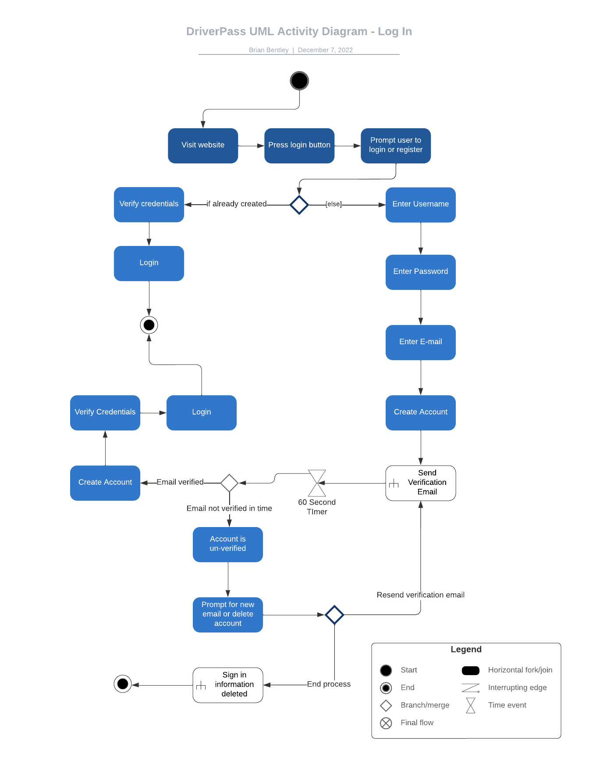
Activity Diagram
Notes:
This Activity Diagram is the login function for our DriverPass system. It will follow the steps of loggin in such as visiting the website, pressing the login button and being prompted to register or login. Then we also include the account creation branch here as well as the verification branch. DriverPass needs a way for new users to create their accounts as well as verifying that they have the correct credentials. This is one of these processes.
We could later on include a flow of the Admin approving user views and privileges.

Slide 5
Security
This design will address security concerns by including a way to authenticate and encrypt users.
User privileges will be kept separate of each other creating an onion of access privileges.
Views will be assigned by the admin that allow access to different site information on an as needed basis such as, “Secretary”, “Admin”, and “Owner”
The passwords will be encrypted and salted in our database which is maintained in the cloud further increasing our systems security.
Notes:
We have considered security in our program.

Slide 6
System Limitations
Unless there is a campus for the school the educational portion will be fully online. Although we will have the teachers be able to meet up with the drivers this will limit our courseroom education to a self learning environment.
The courses and curriculum will have to adhere to State and Federal regulations in order to maintain compliance.
There will need to be a website for the system
The system will be cloud based

